Slide 1
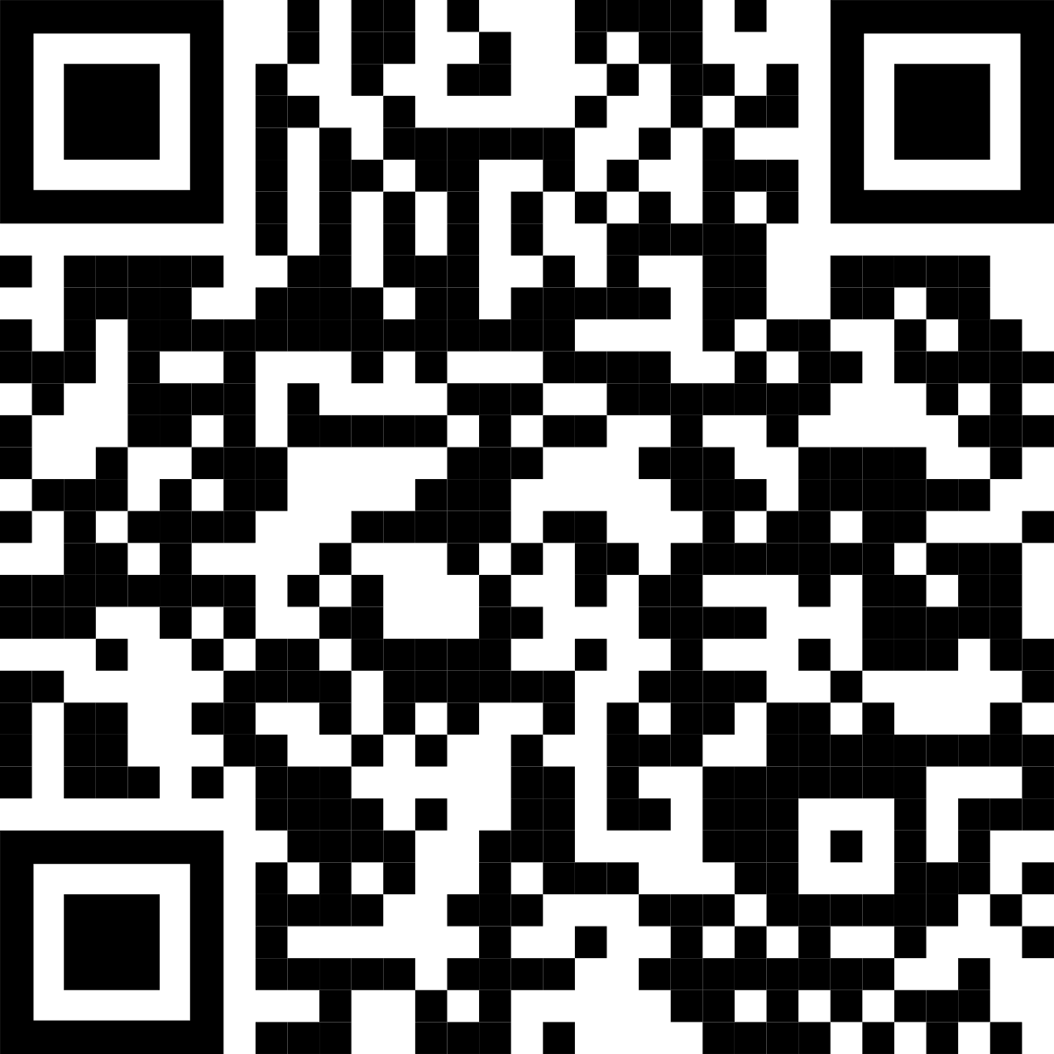
Non-Cognitive Predictors of Student Success: A Predictive Validity Comparison Between Domestic and International Students
Non-Cognitive Predictors of Student Success: A Predictive Validity Comparison Between Domestic and International Students
PRESENTER: Your Names
Title: Subtitle
RESULTS
Graph/table with essential results only.
All the other correlations in the ammo bar on the right.
Your Name, author2, author3, author4
This is a experimental version of #betterposter. Try it if you’re brave and let me know how it goes!
AMMO BAR
Delete this and replace it with your…
Extra Graphs
Extra Correlation tables
Extra Figures
Extra nuance that you’re worried about leaving out.
Citations.
Keep it messy! This section is just for you.
METHODS
How did you find this?
Collected [what] from [population]
How you tested it.
Get full paper
Notes: Try this with no intro, no discussion. Tell me whether you miss it.

